Slide 1

Indoor Scene Recognition
VISHNU PRIYA JYESTA
Master of Professional Studies in Data Science
SPRING 2021
Instructor: Dr. Ergun Simsek

Slide 2
Description
Indoor scene recognition is a challenging open problem in high level vision. Most scene recognition models that work well for outdoor scenes perform poorly in the indoor domain. The main difficulty is that while some indoor scenes (e.g., corridors) can be well characterized by global spatial properties, others (e.g., bookstores) are better characterized by the objects they contain. More generally, to address the indoor scenes recognition problem we need a model that can utilize local and global discriminative information.

Slide 3
Aim
An indoor scene classification method which utilizes CNN feature of scene images to generate scene category features to classify scenes by a novel feature matching ML algorithm and Neural Networks.

Slide 4
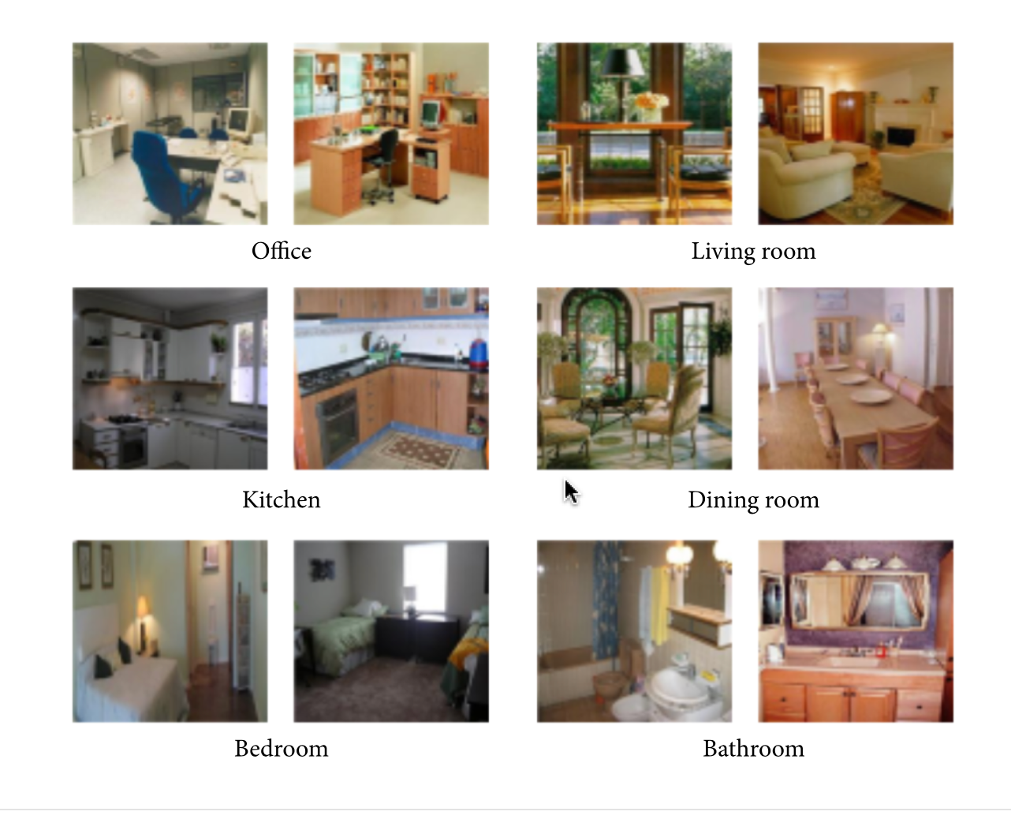
Dataset Information
The Dataset has 67 categories like bedroom, kitchen, garage, game room, airport, salon etc. and each category has at least 100 images and 15,687 RGB images totally.
The size of the Dataset is 2GB.
All these images are in jpg format.
All of 67 categories of indoor scene image are used to train the models.
Source : http://web.mit.edu/torralba/www/indoor.html

Slide 5
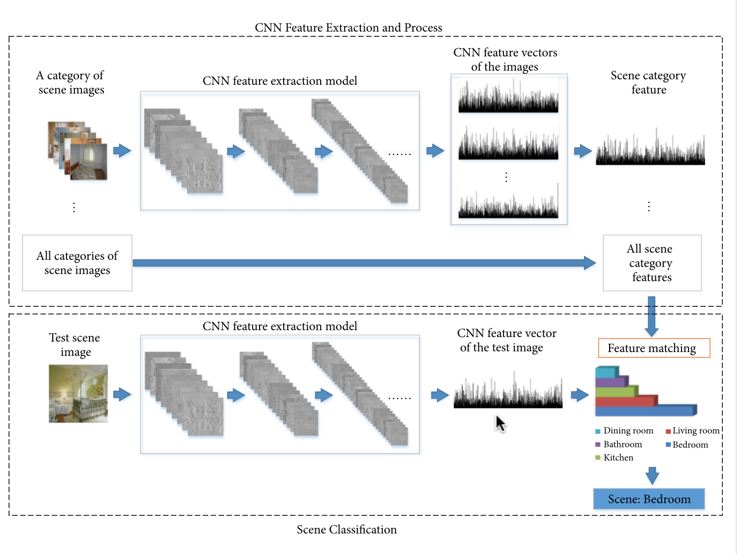
Planned Framework
Overall framework of the indoor scene classification method will be based on CNN feature. There are two parts in the framework. The first part is to generate scene category features by CNN feature extraction and process. The second step is to match CNN feature vector of the test scene image with the scene category features by a new feature matching algorithm to generate scores of different scenes. The largest score indicates the result of scene classification

Slide 6
References
A. Quattoni and A. Torralba, “Recognizing indoor scenes,” in Proceedings of the IEEE Computer Society Conference on Computer Vision and Pattern Recognition Workshops (CVPR Workshops '09), pp. 413–420, Miami, USA, June 2009.
Shaopeng Liu, Guohui Tian, "An Indoor Scene Classification Method for Service Robot Based on CNN Feature", Journal of Robotics, vol. 2019, Article ID 8591035, 12 pages,2019. https://doi.org/10.1155/2019/8591035

Slide 7
THANK YOU
ANY QUESTIONS & FEEDBACK
vjyesta1@umbc.edu

